Slide 1
WELCOME TO CONVENING!

Slide 2
we acknowledge, with gratitude, that our place of work is on the ancestral, traditional and unceded territories of the xʷməθkwəy̓əm (Musqueam), Skwxwú7mesh (Squamish), and sel̓íl̓witulh (Tsleil-waututh) Nations.
Notes:
Land Acknowledgements
Introductions
Reminder that call is being recorded and will be shared with everyone via email for future reference.

Slide 3
AGENDA
Overview of Foundry
Opening a Foundry Centre
Convening Phase- The Next 3 Months
Notes:
Congratulations and welcome to the information session.
Over the next 1.5 hours will be discussing the convening process and what to expect over the next 3-months and what we would like to see form you.
Provide a brief overview of how Foundry came to be.
Should you be approved to implement a Foundry center into you community, what you can expect.
It’s important that you understand the process and the work that needs to be dedicated to opening and operating a Foundry centre.
Our goal is to ensure you are knowledgeable about the process and work.

Slide 4
OVERVIEW OF FOUNDRY

Slide 5
VISION
Foundry’s vision is to transform access to health and social services for youth and families.
We aim to improve qualities such as availability, acceptability, and equitability by creating a network of youth-friendly, single points of access.
Notes:
The Foundry vision is to transform access to health and social services for youth and families by enhancing provincial efforts and through meaningful partnerships with donors, government, and community organizations. We hope to improve qualities such as availability, acceptability, equitability by creating a network of youth-friendly, single access point - where multiple services – health and social services are offered. The centres have all been branded ”Foundry” so that we can grow the general recognition of a respected and trusted brand.
In partnership with the BC Childrens Hospital, we also provide online health promotion resources at foundrybc.ca. And soon we will be providing telephone and chat supports through a virtual clinic model.

Slide 6
Our brand took a year to develop with young people and their families leading the process
FIND HELP, HOPE, SUPPORT, FIND YOURSELF.
FORGE NEW CONNECTIONS AND NEW ABILITIES.
FORGE YOUR PATH FOR WELLNESS.
A FOUNDATION FOR HEALTH AND WELL-BEING.
A FOUNDATION FOR WHO YOU WANT TO BE.
WELCOME TO FoUNDRY
Notes:
Youth and family engagement is at the centre of our work. So when we needed to develop a brand, we first launched a national survey to understand what youth needed or were looking for. We learned quickly that they wanted to come to a place that had multiple services, including mental health, but where no one would know what their needs were by the door they walked through. We learned that there was very little brand recognition and that young people had very little understanding of what health or wellness actually meant. In most cases, it meant the absence of illness- a deficit model.
We engaged young people, parents and caregivers to promote collaborative and respectful involvement in the creation of the Foundry brand. We had braod representation including Indigenous and cross cultural young people. Young people didn’t want to see any mention of mental, or health or head in the name. They also didn’t want the name to be too optimistic. And they wanted to own it
Over every other suggestion, youth choose and embraced the brand of Foundry and informed our key messaging and branding colours and designs.

Slide 7
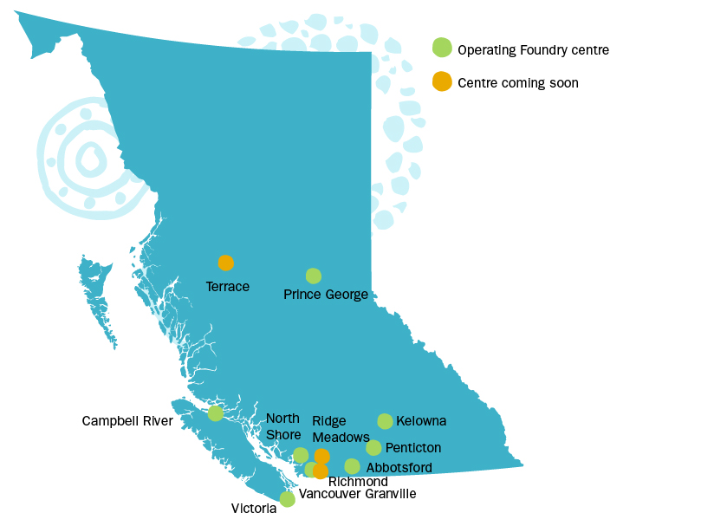
Between 2016-2019, we built 8 centres in BC and by early 2020 we will have 2 in each health authority
Notes:
We selected our first 11 sites through an expression of interest and convening that took 5 months to complete. In 2015 we opened the prototype at Foundry Vancouver- Granville. Between 2016-2018, we opened 5 more centres as part of Phase 1. Phase 2 has seen 2 more centres open, with 3 more on the way.
British Columbia is a large province, with more than half of its population residing in the Lower Mainlaind, near stretching from Vancouver to Hope. Over 2.5 million people live here. Our hope is that someday, 95% of young people will be within a 30 minute drive of a Foundry Centre and that 99% have access to our virtual care.
Our communities are divers in size and in geographic location, with both urban and rural settings. Our most recent addition, Foundry Penticton, opened in June, 3 years after first submitting its expression of interest.
Tanya wil discuss the process and the benefits of working with the Foundry Central Office team.

Slide 8
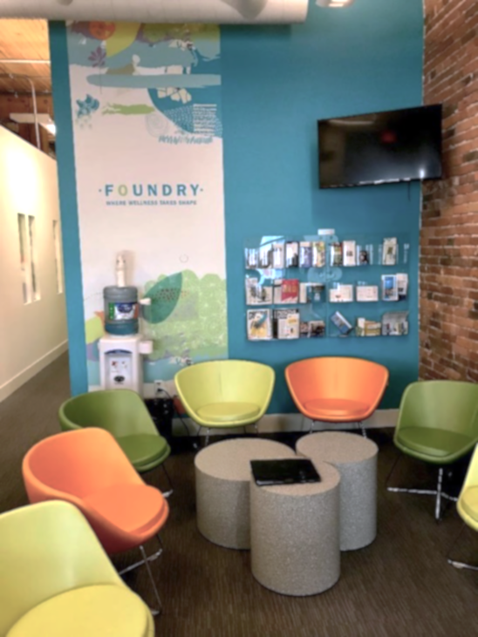
Our Foundry centres have similar brand elements but are tailored to the needs of the local community and they are co-designed with young people and their families

Slide 9
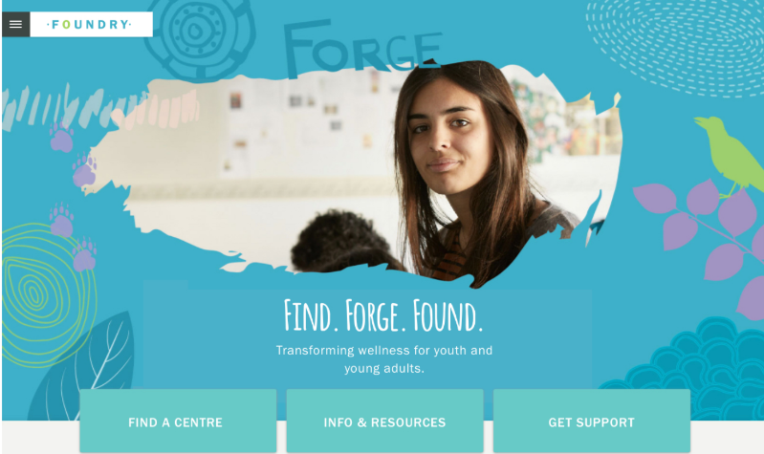
foundrybc.ca, in partnership with BC Children’s Hospital, provides online self-help tools and hope-filled “Stories”
Notes:
Foundry is also an online resource, launched in partnership with the BC Children’s Hospital and funded by RBC.
Foundrybc.ca has a navigation tool to help young people and families find the help they need regardless of their community. Foundry online also has a “Stories” section, bringing the stories of hope and recovery from a number of young people with lived experience so that our audience is inspired to seek help.
It also has resources if there is a need for help in the moment as well as some self help tools.
We have big aspirations for Foundry online, and look forward to adding a virtual clinic to our suite of services.

Slide 10
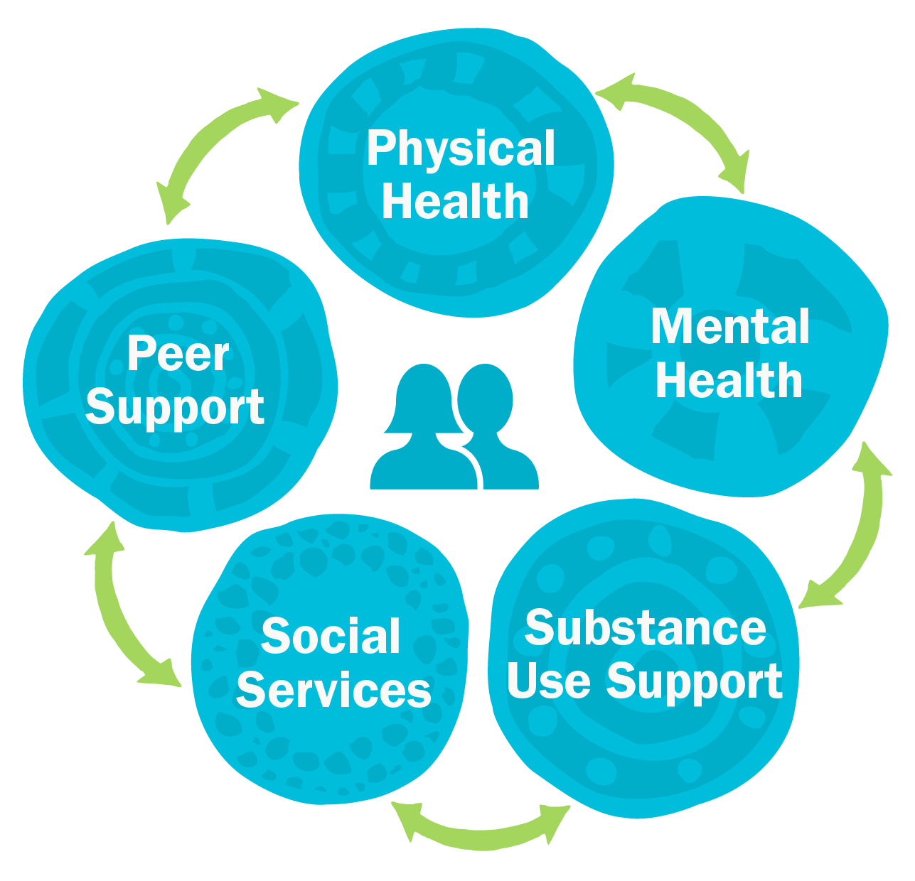
Foundry centres offer 5 core services, including peer to peer, and MHSU services delivered using Foundry’s integrated stepped care model (ISCM)
Notes:
Go over 5 service streams briefly. ISCM is focused on MH & SU streams and includes service provision by the other streams, which we will illustrate when we get into the details.

Slide 11
Foundry’s Governing Council advocates for us and advises on strategic government relations and ministerial work
Policymaking ministries & key legacy funders make up Foundry’s Governing Council:
Graham Boeckh Foundation
Michael Smith Foundation of Health Research
Ministry of Health
Ministry of Mental Health and Addictions
Ministry of Children and Family Development
Providence Health Care
St. Paul’s Foundation
Notes:
Foundry is a unique partnership. For years policy documents existed citing the importance of integrated care and improved access in community services, particularly in the Child and Youth Mental Health service sector.
But in 2015, a small but nimble “governing council” was created to shepherd the initiative forward with representation at the Assistant Deputy Minister level initially from two and later three key policymaking ministries (Health, Children and Family Development and recently Mental Health and Addictions) as well as key legacy funders: St Paul’s Hospital Foundation, Graham Boeckh Foundation and the Michael Smith Foundation for Health Research. Senior leadership from Providence Health Care and the Executive Director and Directors from Foundry, round out the Governinv Council
Early on, the Council was focused on establishing the necessary funding and the supportive “backbone” structures needed to establish Foundry. This included fiscal accountability, and support for the establishment of a data collection platform, human resources, finances and government communications.
The Council’s focus more recently shifted as the Ministry of Mental Health and Addiction was added to the Council, bringing a more strategic lens as Foundry was embedded in the long term plan for the province moving forward.
Because of the inter-ministerial nature of the work, this council has been invaluable to addressing many of the overarching issues and have permitted Foundry to move forward in what historically has been a challenging domain.

Slide 12
Abbotsford Division of Family Practice
Abbotsford School District (School District 34)
Aboriginal Education Council
Access Centre Penticton
Alouette Addictions Services
ARC (Adult Residential Care) Programs
Archway Community Services
BC Housing
BC Schizophrenia Society Penticton
BrainTrust Canada
Broadway Youth Resource Centre
Campbell River and District Division of Family Practice
Campbell River Community Literacy Association
Campbell River Family Services
Canadian Mental Health Association
Canadian Mental Health Association North
And West Vancouver Branch
Canadian Mental Health Society – South Okanagan
Central Okanagan Divisions of Family Practice
Central Okanagan Food Bank
Child and Youth Mental Health and Substance Use Collaborative Central Okanagan Local Action Team
Children’s Health Foundation of Vancouver Island
City of North Vancouver
Coast Mental Health
Community Foundation of the South Okanagan
Community Living BC
Covenant House
District of North Vancouver
Family Smart
First Nations Health Authority
Fraser Health
Fraser Valley Aboriginal Children and Family Services Society
Fraser Valley Youth Society
Graham Boeckh Foundation
GT Hiring
Hollyburn Family Services
Impact Youth Substance Use Services
Institute of Families/The FORCE Society
Interior Health
Island Health
Justice Education Society
Kelowna Community Resources
Kwakiutl District Council
Maple Ridge-Pitt Meadows Community Services
Maximus Canada (Operating as Work BC)
Ministry of Children and Family Development
Ministry of Health
Ministry of Social Development & Poverty Reduction
Ministry of Social Development and Social Innovation
Michael Smith Foundation for Health Research
Moms Stop the Harm
North Island Employment Foundation
North Vancouver School District
Northern Health
Okanagan Boys and Girls Clubs
OneSky Community Resources
Options for Sexual Health
Pathways - Addiction Resource Centre
Prince George and District Elizabeth Fry Society
Prince George Division of Family Practice
Providence Health Care
Provincial Health Services Authority – Trans Care BC
Reach Out Youth Counselling
Richmond Addictions Service Society
Sasamans Society
School District 23
School District 57
School District 72
SMART Recovery
SMART Umbrella Society
South Okanagan Brain Injury Society
St. Paul’s Foundation Stepping Stones Counselling Group Terrace and District Community Services Society
The Bridge Youth and Family Services
The Intersect Youth and Family Services Society
The John Howard Society of North Island
University of British Columbia – Okanagan
University of British Columbia Family Practice Residency Program
Urban Health Research Initiative
Vancouver Coastal Health
Victoria Native Friendship Centre
Victoria Youth Clinic
Victoria Youth Custody Services
Vinyasa Yoga for Youth
WCG Services
West Vancouver School District
Work BC
YMCA of Northern BC
YMCA of Okanagan
Foundry is 140+ partners working together under one brand
Notes:
Each Foundry centre is led by a local agency, most often a nonprofit (but sometimes a health authority) who engage deeply with their communities and bring together local partners – including school districts, government agencies, Indigenous organizations, and non-profit community based, service providers – to ensure their Foundry centre meets the needs of their young people and families.

Slide 13
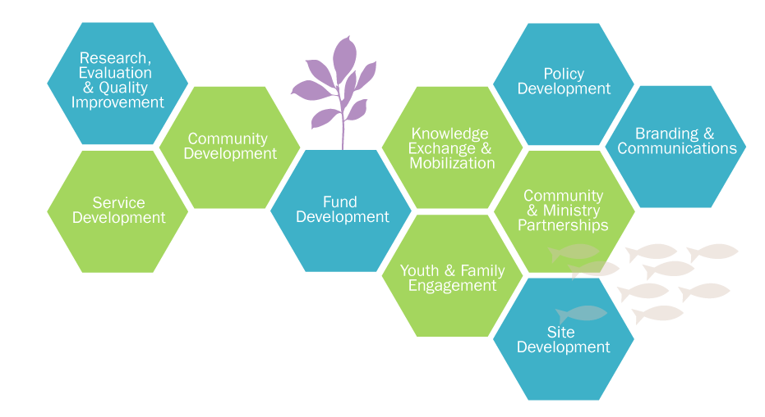
Foundry central office is the bridge between lead agencies, health authorities and government
Notes:
In order for the Transformation to take place, a team of content experts was needed to support community organizations, already stretched thin and often lacking the resources or the time , to implement an integrated community health and social service model.
Foundry began as a collective impact initiative- in many aspects, we were open to understanding from the communities first what they needed, then who could work together, and finally what services and how they wanted to provide them.
Based on this early work, we built a central team with expertise in:
Youth and Family engagement
Clinical operations and planning
Community and government relations
Service Development and Implementation
Knowledge exchange and mobilization
Project management and site development
Policy Development
Branding and communications
Research and evaluation
Our goal is to not to provide “Foundry in a box”. Rather it is to provide community led initiatives to have access to refined to tools and lessons learned from our 8 successful launches so that they can create spaces that reflect their communities and state of the art information.

Slide 14
Foundry’s lead agencies are contracted to provide the operational leadership for the Foundry centre and services
Roles and responsibilities for the Lead Agency includes:
capital project development
fundraising
partnership development
youth and family engagement
centre operations
service delivery
provincial knowledge exchange network membership
evaluation implementation
Notes:
Role of Foundry Lead Agencies
Foundry centres are operated by Lead Agencies based in the communities where centres are located. Opening a Foundry centre requires significant time and effort. In early stages, this typically includes dedicated time from senior leadership. In later stages, when the focus moves to service delivery, this will shift and require more time from management and operations staff, including those hired through Foundry operations grants.
Each Lead Agency is responsible for the development and operations of their Foundry centres and for ensuring the community’s needs are reflected within. Lead Agencies lead local activities, including capital project development, fundraising, partnership development, youth and family engagement, communications and centre operations.
Lead Agency leadership and staff, including youth and family advisors and peer supporters, participate in the larger provincial network. This is primarily through knowledge exchange and training opportunities, communities of practice, working groups, and by providing advice to the Foundry central office and other Lead Agencies.

Slide 15
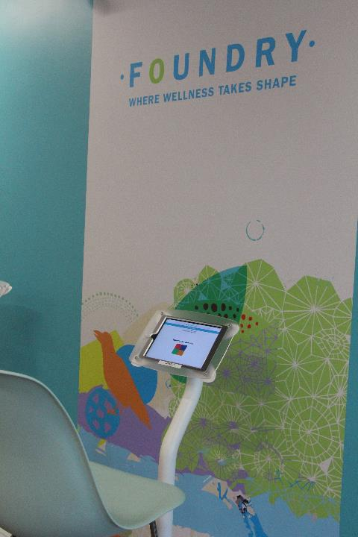
Toolbox is Foundry’s data collection system, designed to show that our services are making a difference
Toolbox is a tablet-based electronic system developed to improve the delivery of integrated care at Foundry centres as well as support evaluation, quality improvement and research activities
Notes:
To show that our services are making a difference, we developed a data-collection tool called Toolbox
TOOLBOX is an electronic system developed to enhance delivery of integrated care at Foundry centres as well as support evaluation, quality improvement and research activities

Slide 16
Foundry centres have seen over 13,411 unique young people from May 2018 to December 2019 accessing our core services

Slide 17
Our Developmental Evaluation helped us understand how intentional integration supports system transformation
Notes:
Developmental evaluation (DE) is an evaluative approach that supports dynamic, complex, and innovative interventions with the capacity for real time decision-making and course correction. Between 2016-2018, we used DE to understand how intentional integration supports system transformation.
Stakeholders at all levels recognized the need for effective collaboration, focused leadership, and formalizing action plans to facilitate integration.
Accounts of this work emphasized supported and deliberate actions to dismantle service and system siloes, navigating and utilizing existing community resources, and the importance of
Achieving the system transformation necessary to implement Foundry’s Integrated Stepped Care Model (ISCM) required stakeholders to engage in the beginning with forming partnerships and building relationships, which enabled collaboration and integration without which implementing ISCM would have been impossible.

Slide 18
Foundry’s expansion was included in the Ministry of Mental Health and Addictions’ “A Pathway to Hope”, a plan to improve the health and wellness of all British Columbians
Notes:
Released in June 2019, the ”Roadmap” makes clear that Foundry will be rolled out to communities province-wide over 10 years. Our current funding is for the first 3 years of the plan.

Slide 19
opening a Foundry Centre

Slide 20
We have learned that the transformation and integration is more than a 3-year process
Optimization to Full-Fidelity
Opening & Implementation
Orientation, Planning &
Development
Selection & Engagement
Notes:
Moving to fully integrated care delivered by multiple partners at each Foundry centre
Challenges to service model fidelity and integration
Primary care – physician compensation to support PC services to level needed in a community – eg Victoria with PC foundation via VIHA vs CR with SS foundation and the expense yet same HA
Where resources may be available in a community, not all partners participate fully which is seen as a systems barrier to integration – not contributing in-kind to service delivery – in-kind partnership is fundamental to the model - variable across the province. Eg of contributing partnerships – CYMH (PG one SDA), HA (Klna), DFP (Abby with MCFD & HA sessions & NP) , MSDPR (VG Income Assistance, STADD)

Slide 21
Building a Foundry centre is just the tip of the iceberg... There is so much more to transformation than meets the eye
A Foundry centre is “built” on 3 essential components
facility/infrastructure
operations
individuals (partners, youth and family)
Successful project outcomes involve transformation and readiness of all 3 components together

Slide 22
What is beyond the establishment of a Foundry centre?
Orientation, Planning & Development
Doors Open
Implementation
Optimization
Planning/Operationalization
Partnership/Engagement
Services
Capital
Fundraising
Training & Preparing for opening
Continuous Optimization
Intentional integration
Services
Quality Improvement
Evaluation
3 mos
6 mos
9 mos
12 mos
15 mos
18 mos
21 mos
24 mos
24– 36 mos
Communications, Change Leadership, Engagement, Knowledge Exchange

Slide 23
Convening Phase- The Next 3 months

Slide 24
So what is the purpose of the “Convening Phase”?
BUILDING RELATIONSHIPS WITHIN COMMUNITIES AND PROVINCIALLY
UNDERSTANDING WHAT FOUNDRY IS
BUILDING PROVINCIAL MOMENTUM
ESTABLISHING READINESS OF OUR COMMUNITIES
Notes:
The Convening process will focus on the viability of submissions – i.e. an agency’s readiness to successfully open and operate a Foundry centre. We are so excited to get to know you, your organization and the amazing work you do through this process.
Building relationships: The Developmental Evaluation from Foundry’s Proof of Concept Phase (2015-2018) showed that Foundry is “all about relationships”. It is those relationships – in communities and provincially – that have made Foundry successful so far. Convening will support relationship-building and networking between communities, with Foundry central office and the Foundry network leadership.
Understanding what Foundry is: We have also heard strongly from members of our existing network of centres that new organizations and communities should be provided with as much information as possible before being identified to lead the development and operations of a Foundry centre, so as to establish realistic expectations regarding what Foundry is (and isn’t).
For example, through convening, you’ll learn what Foundry Isn’t:
- Tokenistic (instead we ensure meaningful engagement with youth and families and partners)
- not a franchise (not out of the box, developed with the needs of youth, family, community, partners, etc)
- not a funder (we work closely with you)
not a one and done (continuous learning organization)
We’ll also provide you with the information you need to know to move forward with convening as best as possible, including the development of partnerships in your communities.
Learn more about the unique strengths and needs of your community, your organization(s) and the incredible work you’re doing, and ensure your questions are answered.
Building Provincial Momentum: While this current phase of our expansion is intended to identify at least six communities to move forward in establishing a Foundry centre over the next three years, our hope is that we’ll be looking at subsequent phases of expansion in the near future where every community represented on this call will see a Foundry centre become a reality
Establishing readiness of our communities: Determine the viability of your organization and partners to lead your community in the development of a Foundry centre. Ascertain fit with the Foundry model and vision by providing information about Foundry from members of our central office and our network.

Slide 25
What you can expect in the next 3 months
Written application and partner letters of support
Phone interview with your Executive Director and Board Chair (or equivalent)
Letters of commitment from HA, MCFD, FNHA, Others
2-day in person knowledge exchange session with current Foundry young people & families and Foundry centre leadership in Vancouver
Decisions communicated mid-March 2020
Notes:
Written application
You’ll have received the template for this written application on Friday (note it’s also saved on our web portal foundrybc.ca/expansion2020-convening/)
Topics will include; leadership, budgeting, details of existing services, engagement practices, cultural safety, inclusivity and diversity and other technical bits
We’ll also be looking for documentation to support your submission, including copies of your audited financial statements where available, a copy of your Certificate of Incorporation for Incorporated Organizations
An org charter or depiction of your organization’s organizational and governance structures
And Letters of support from agencies you’re currently partnership with and plant to partner with.
Phone interview with your Executive Director and Board Chair (or equivalent) will be scheduled based on your availability between Jan 20 – Feb 14.
Over the course of these four weeks, Foundry central office team members, Foundry network leaders and youth and family members from our provincial advisory groups will conduct phone interviews with the Executive Director of your organization and your Board Chair (or equivalent).
The purpose of these calls is to
i) explore follow-up questions we received from our EOI evaluation panels,
ii) to understand your organization’s commitment to and capacity to take on Foundry and
iii) understand how you’re working with youth and families in your community.
These interviews will likely be done either by conference calls or videoconference calls. There will likely be four panel members on the interview including someone from Foundry central office, a youth from our provincial advisory council, a family member from our provincial family ambassador council and a leader from one of the eight open Foundry centres. The interviews will be one to one and a half hours in length.
Letters of commitment from HA, MCFD, FNHA, Others
As we have provincial relationships with these bodies, we will be coordinating letters of commitment from them. (this ensures provincial coordination)
Mandatory 2-day in person knowledge exchange (Mar 2 and 3)
Relationship building, knowledge exchange and networking between communities
Offers an opportunity for you to meet youth, family and leaders from the network of centres across the province, along with staff from Foundry central office.
Final Evaluation
Based on results from EOI, written submission, learnings through the in-person session and interviews

Slide 26
Our Convening Phase timeline is relatively tight but aligns with fiscal year end and allows us to onboard before the start of summer
2-Day Gathering in Vancouver Mar 2-3
Final Evaluations Mar 4
Written Submission & Partner Letters Due Feb 20
Selected Communities Announced Mid-Mar
Info sessions - Jan 7 - Info - Jan 14 – Q&A
Phone Interviews Jan 20 – Feb 14
January 2020
February 2020
March 2020

Slide 27
Convening will be evaluated by a series of tasks, some already completed with a final decision by early March 2020
Results of EOI phase
Interview
Convening written submission
Letters of support
In-person convening session

Slide 28
Here are our Next Steps with you
Q&A Session – January 14, 2020
Process for submitting questions
Interviews – January 20-February 14, 2020
Scheduling reminders and details
In-Person Convening in Vancouver, BC – March 2-3, 2020
Booking travel & accommodation
Notes:
Process for submitting questions: After this call, if you have questions you’d like addressed during the Q&A session, please submit them using our online webform, which will go live on https://foundrybc.ca/expansion2020-convening/ right after we’re finished with this call. We’d like to receive as many of your questions as possible in advance.
Beyond the Q&A session, as questions come up through Convening, please submit your questions using this form. We’ll publish our responses to your questions on the web page (unless you ask us not to) and will send you our responses directly. You can do this right up until the inperson convening session
For interviews: thanks to everyone for providing their availability. We’re just waiting on a handful of communities to confirm this. My colleague Sarah Lally will then be following up with each one of you to confirm the date and time for this interview.
For the in-person convening, please refer to the Convening information package re. details for booking your travel. WE will reimburse you for your travel expenses according to the guidelines contained in the info pack. However, we’ll be booking your accommodation for you. My colleague Sarah will be in touch with you to confirm who from your organization will require accommodation.

Slide 29
Thank you! Questions?

